Slide 1


ReConnect China Report
Phase i. – Web of Science Co-publication analysis

Slide 2





Scope
Keywords related to AI, Machine Learning & Big Data
Web of Science: Europe & China co-publications
(EU28+NOR+UK+CHE)
Qualitative analysis of the 2011-2022 period

Slide 3
Methods
Identification & QA/QC of potential keywords and syntax (248) → refined tokens (210)
Classification of publications via journal METRIX taxonomy (based on ISSN)
Leveraging WOS „topic search” methodology: Title, Abstract, Keywords, Author Keywords
Documented and automatized query composition
Author address fields → Country, Institution (harmonized)

Slide 4
Additional methods & Data Processing Results
Query → 56196 individual entries from WOS
Number of METRIX indexed & non-duplicate records: 49839
Ad-hoc re-merge of unindexed entries using WOS taxonomy - METRIX taxonomy correspondences: +2065
After excluding „pseudo co-publications”: 46060

Slide 5
Overall Distribution & Trends

Slide 6
GLOBAL TRENDS
Constant increase in scholarly output in each domain
Domination of applicational aspects
Recent relative increase of collaboration within economic domains

Slide 7
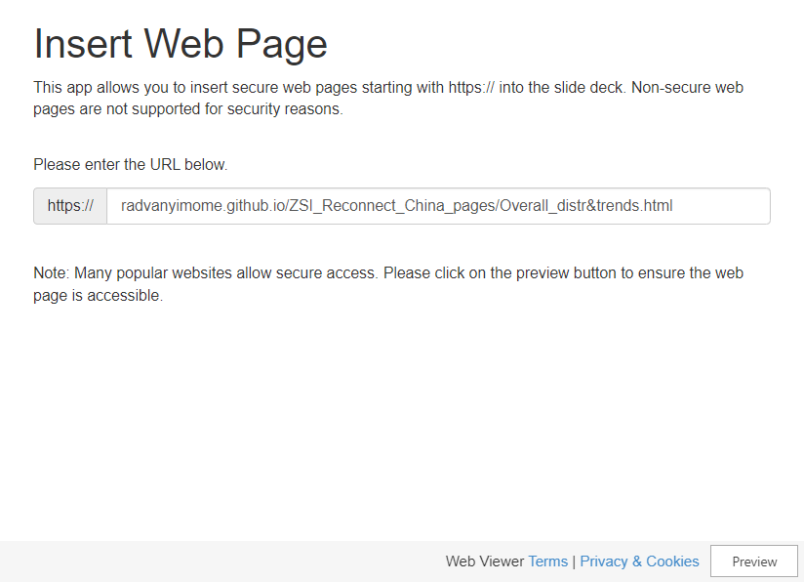
Overall Distribution & Trends (DYNAMIC)
Topic of scope dominated by applicational aspects
Constant increase in scholarly output
Comparison with global trends?

Slide 8
Overall Distribution & Trends (STATIC)
Topic of scope dominated by applicational aspects
Constant increase in scholarly output
Comparison with global trends?

Slide 9
Distribution & Trends: Scientific Domains
Constant increase in scholarly output in each domain
Domination of applicational aspects
Recent relative increase of collaboration within economic domains

Slide 10
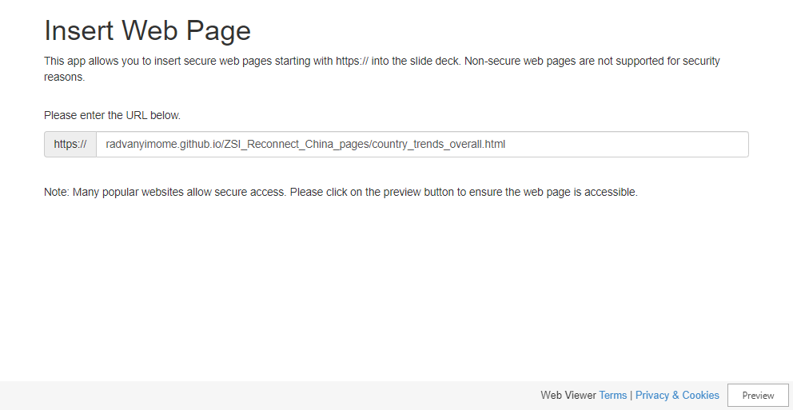
Distribution & Trends: COUNTRY-LEVEL (DYNAMIC)
Topic of scope dominated by applicational aspects
Constant increase in scholarly output
Comparison with global trends?

Slide 11
COLLABORATION PATTERNS: COUNTRY-LEVEL (EUROPE)

Slide 12
Distribution & Trends: COUNTRY-LEVEL
Topic of scope dominated by applicational aspects
Constant increase in scholarly output
Comparison with global trends?

Slide 13
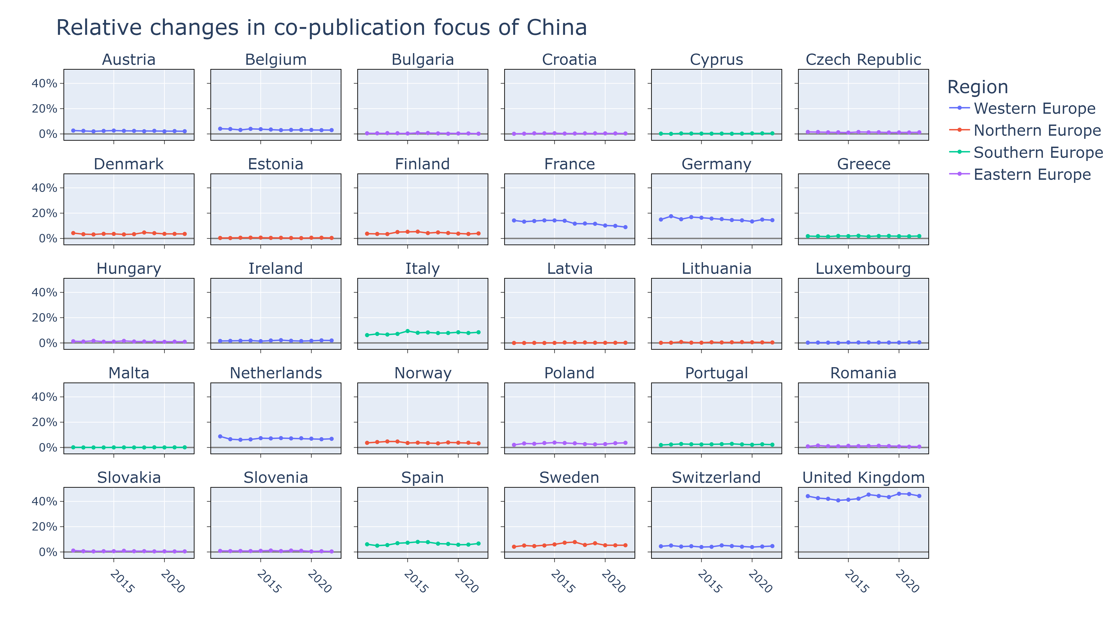
Distribution & Trends: COUNTRY-LEVEL
Topic of scope dominated by applicational aspects
Constant increase in scholarly output
Comparison with global trends?

Slide 14
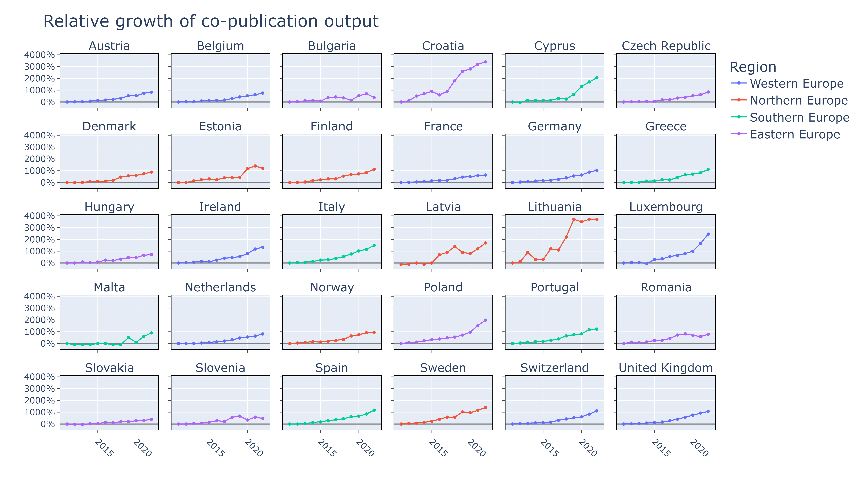
Distribution & Trends: COUNTRY-LEVEl
Topic of scope dominated by applicational aspects
Constant increase in scholarly output
Comparison with global trends?

Slide 15
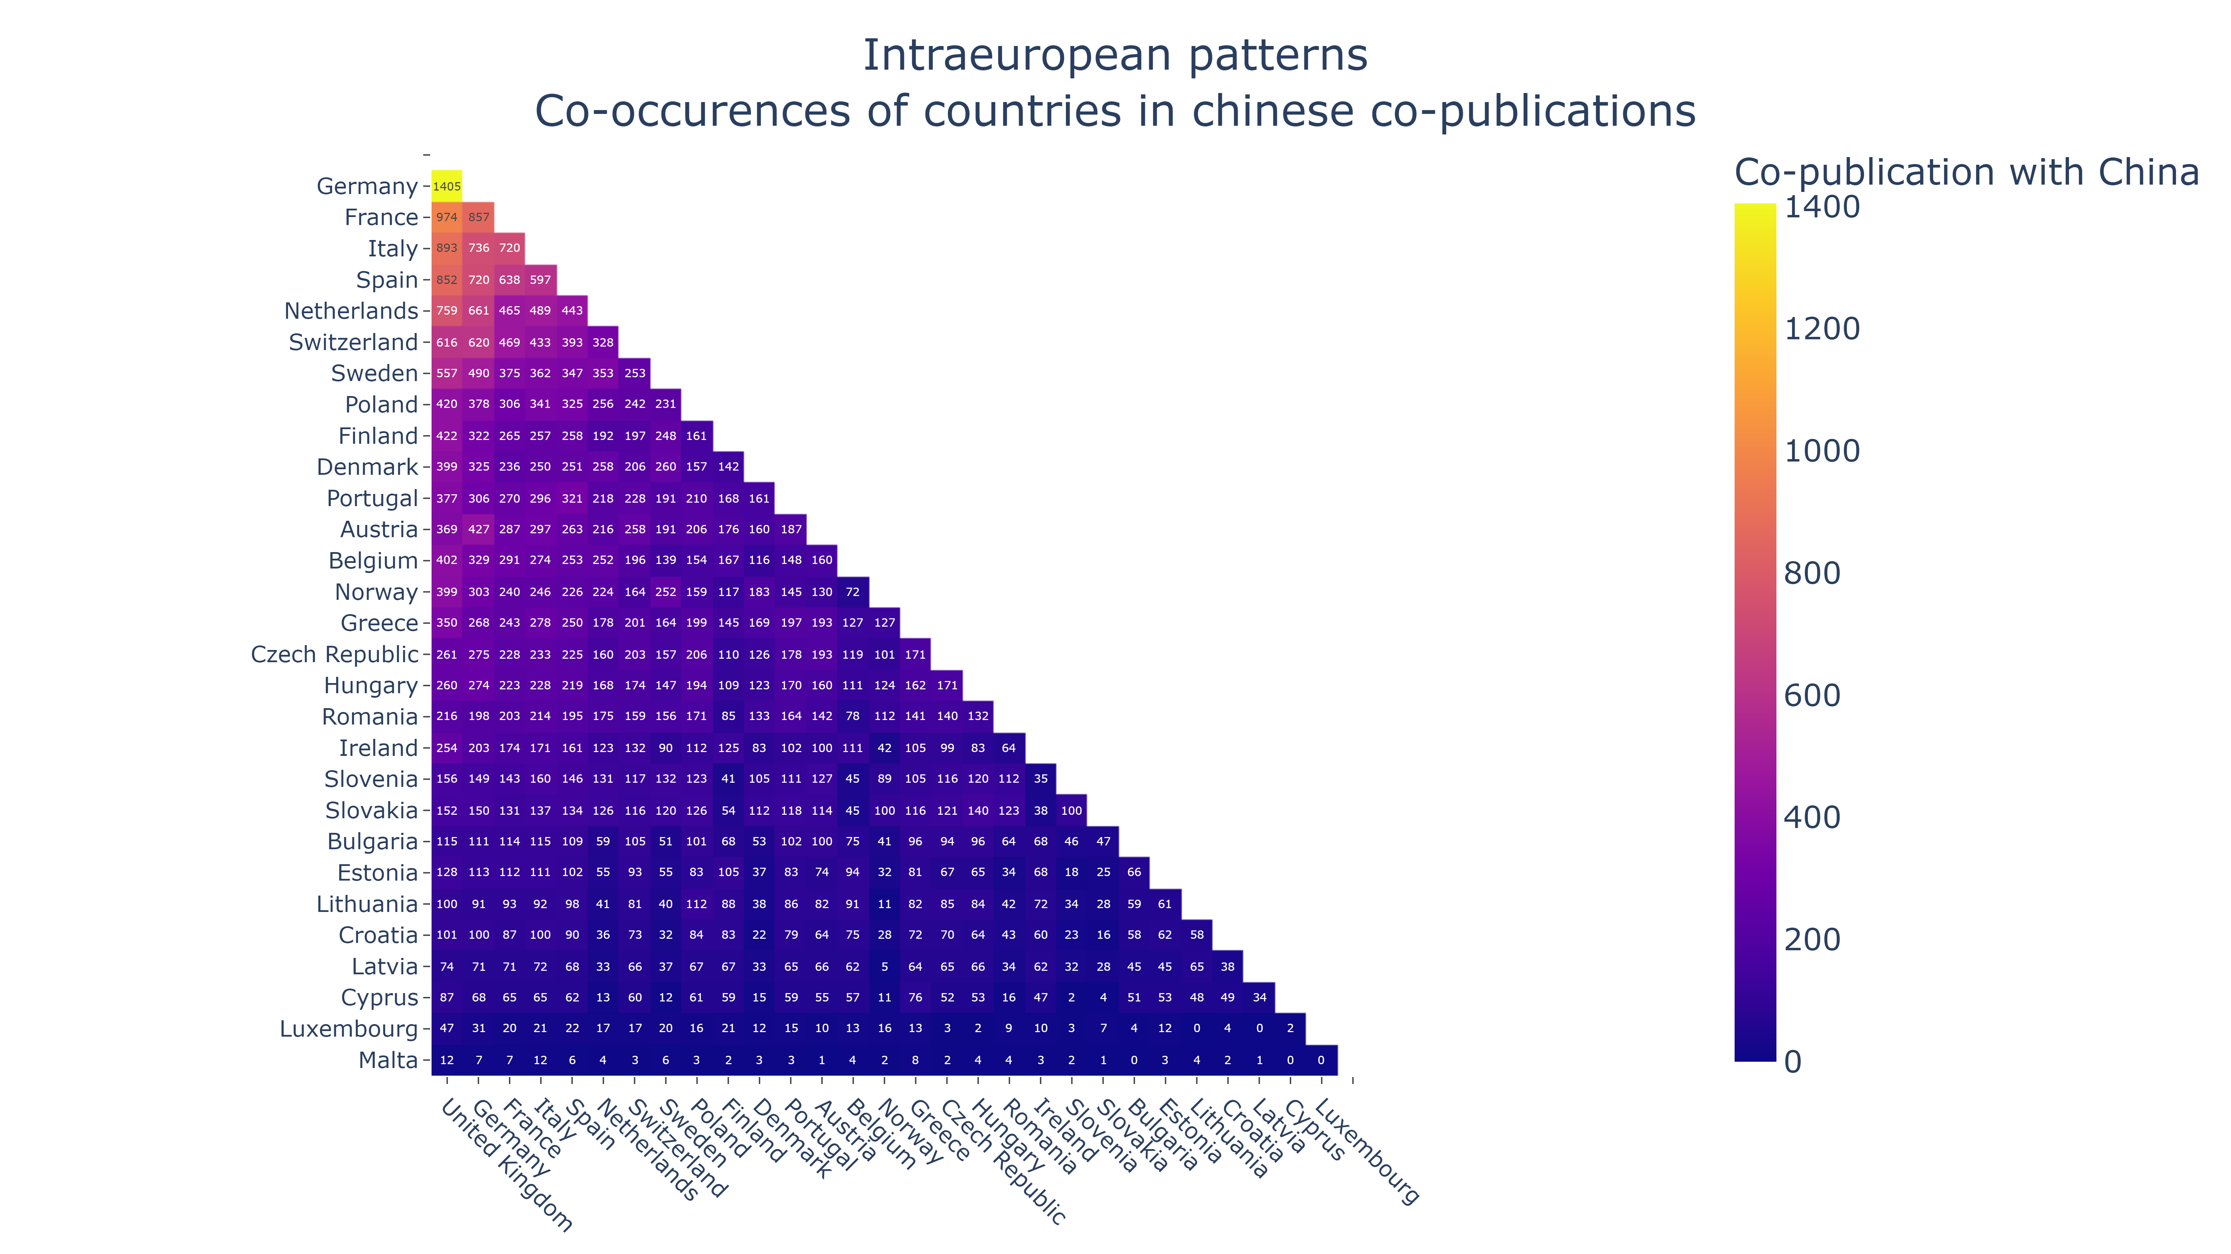
COLLABORATION PATTERNS: COUNTRY-LEVEL (WITHIN EUROPE)
Topic of scope dominated by applicational aspects
Constant increase in scholarly output
Comparison with global trends?

Slide 16
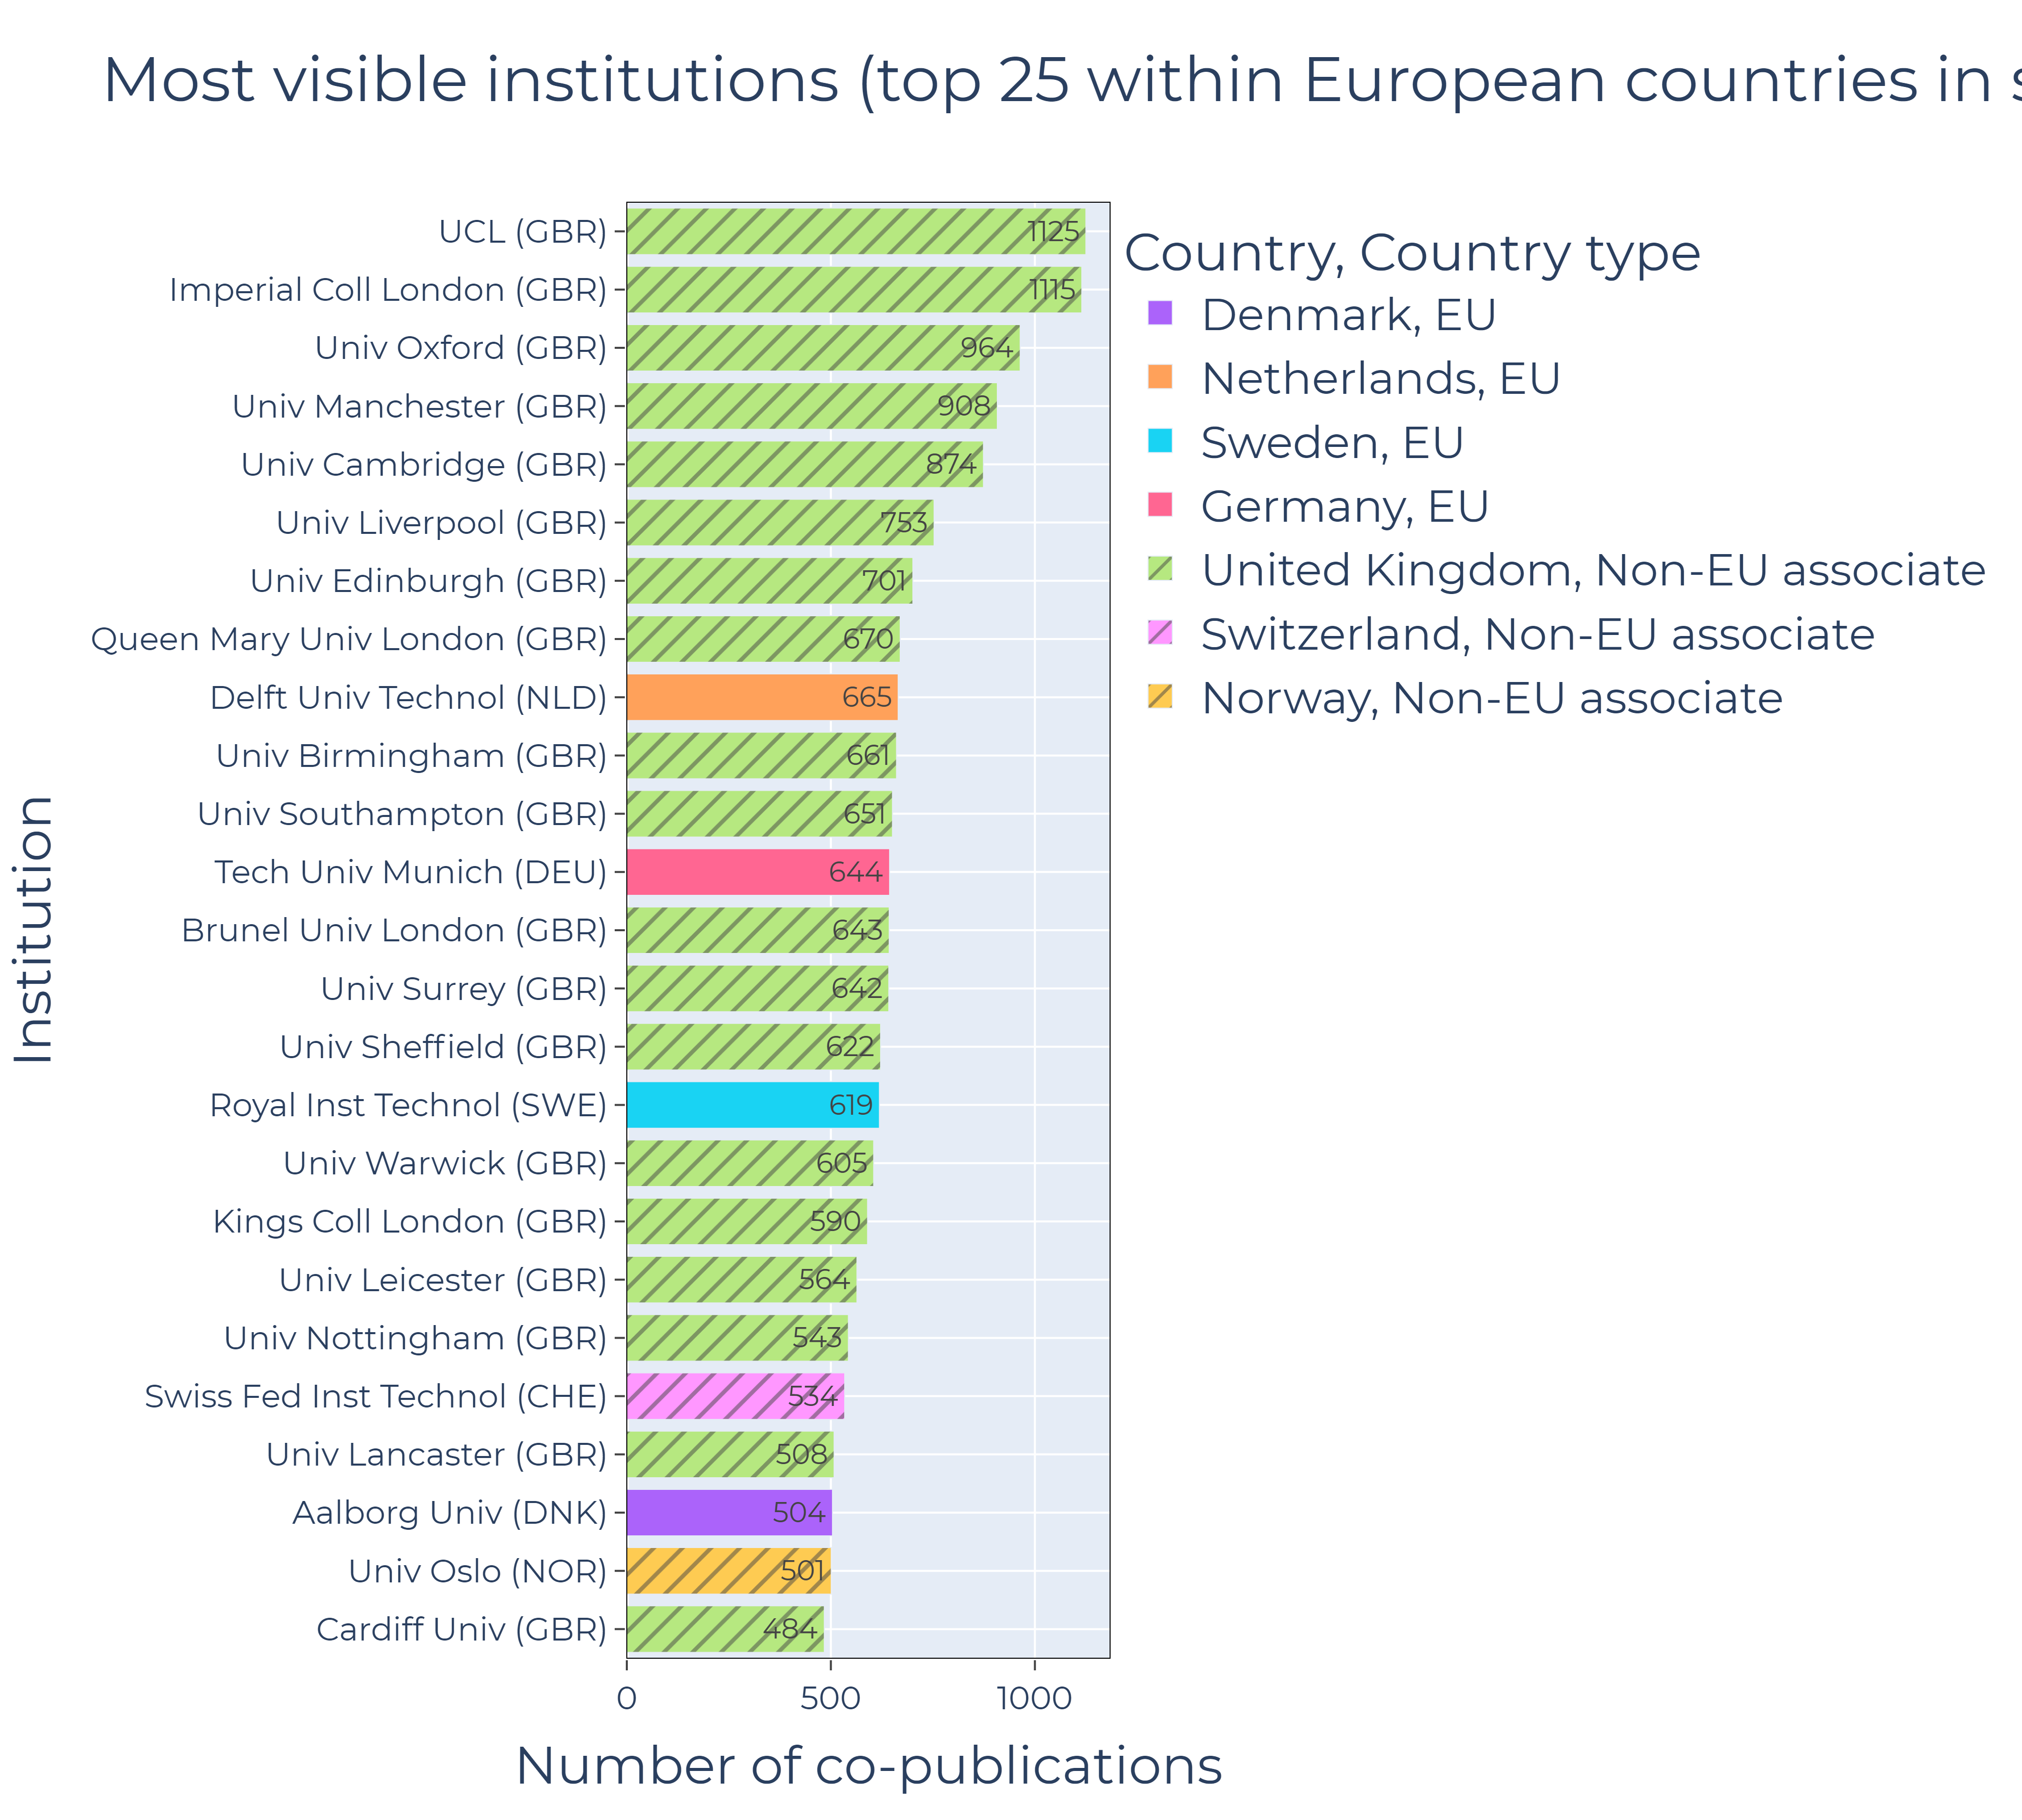
COLLABORATION PATTERNS: INSTUTITION-LEVEL (EUROPE)

Slide 17
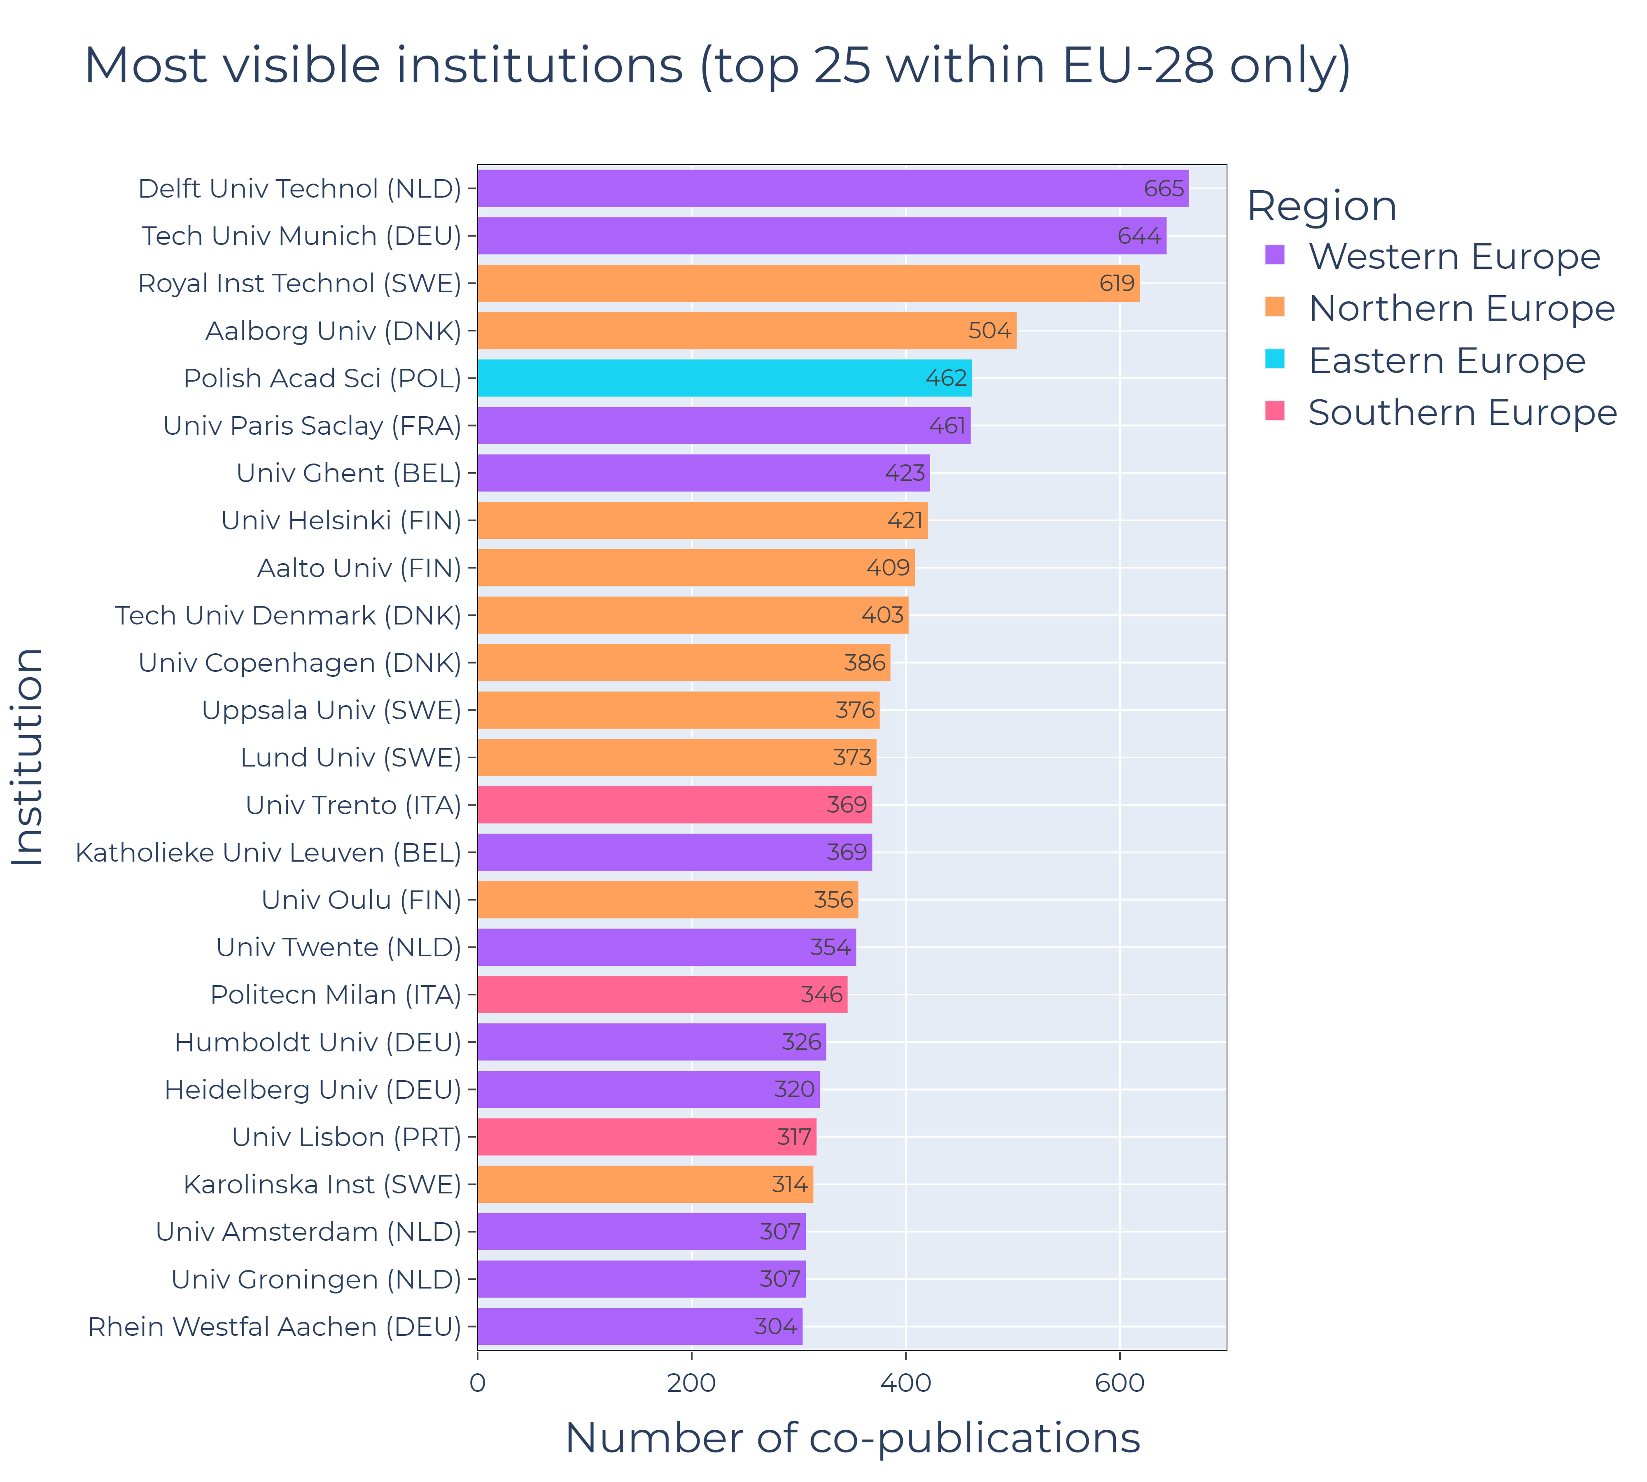
COLLABORATION PATTERNS: INSTUTITION-LEVEL (EU28)

Slide 18
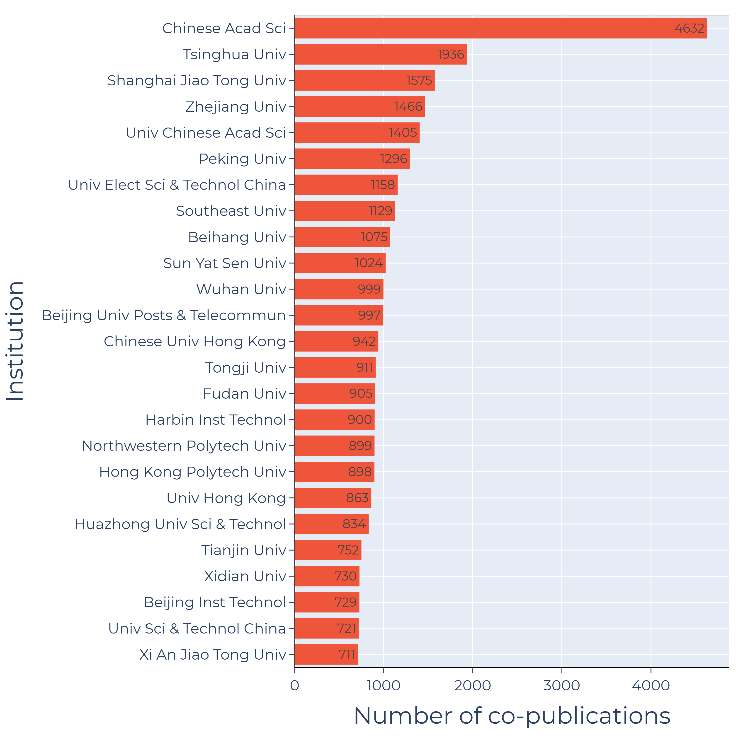
COLLABORATION PATTERNS: INSTUTITION-LEVEL (EU28)

Slide 19
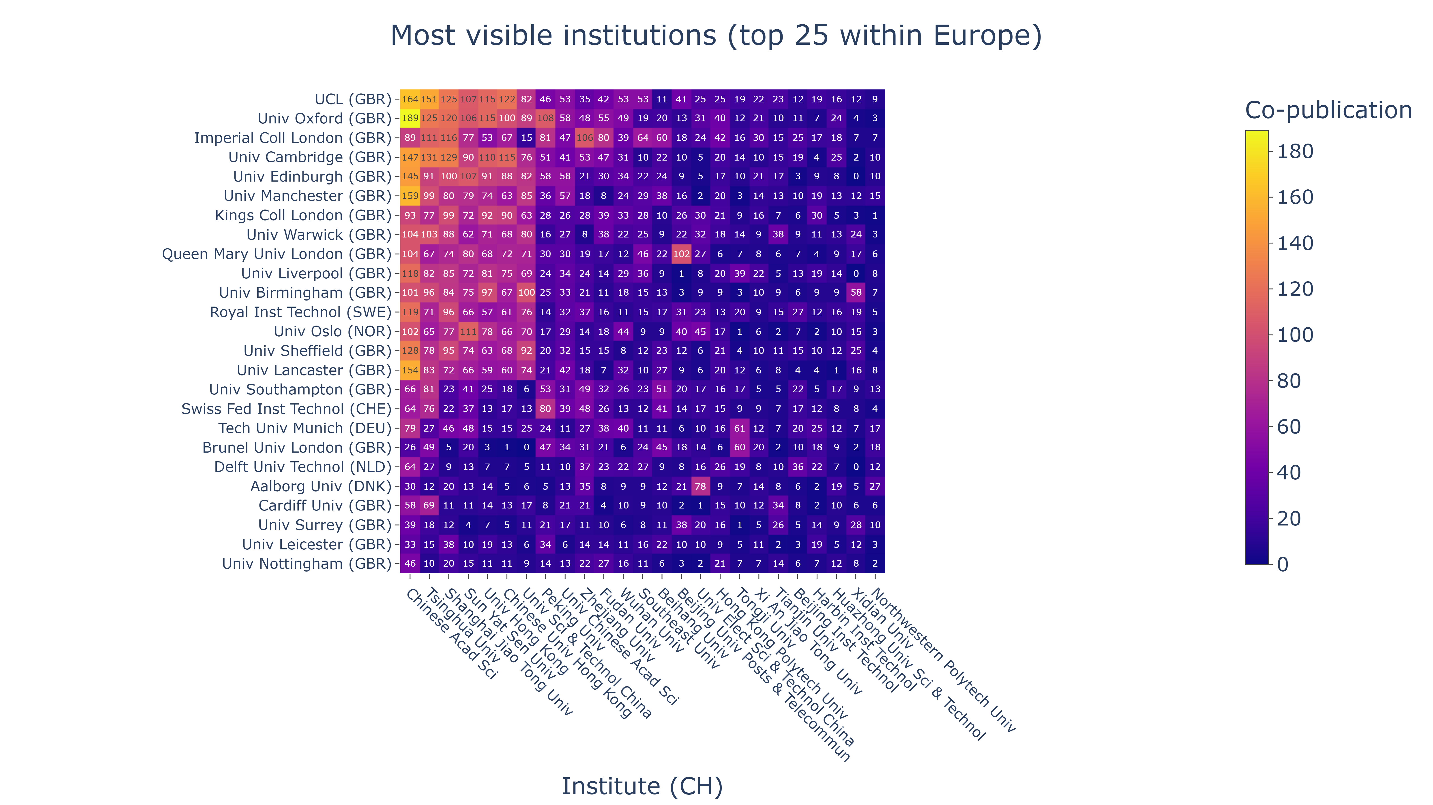
COLLABORATION PATTERNS: INSTUTITION-LEVEL (EUROPE)

Slide 20
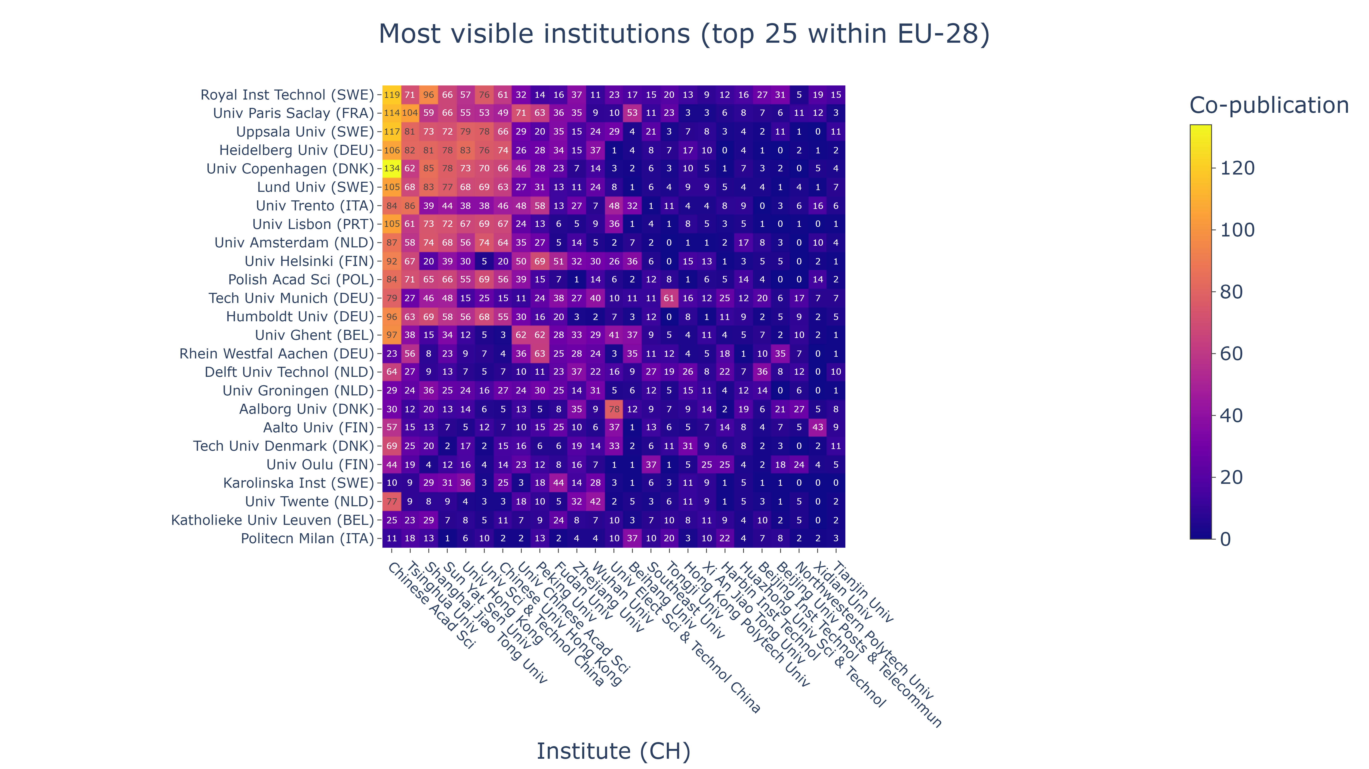
COLLABORATION PATTERNS: INSTUTITION-LEVEL (EU28)

Slide 21

ThAnk You
valaki@example.com

Slide 22

TemPLATE
Bullet point 1
Bullet point 2

Slide 23
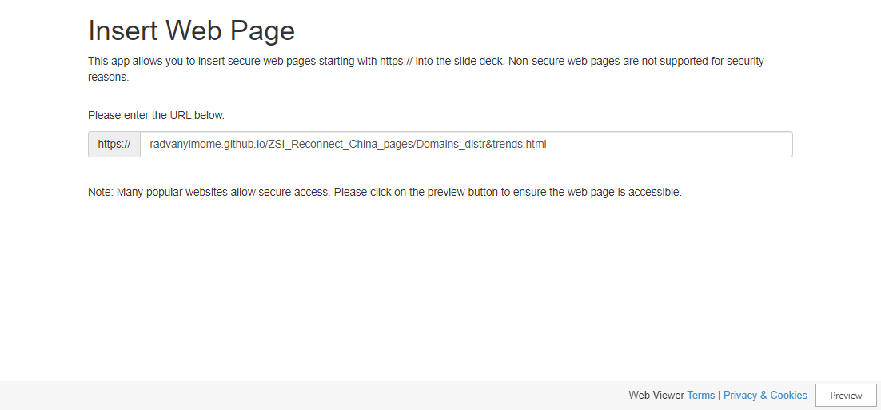
Slide 2

Slide 24
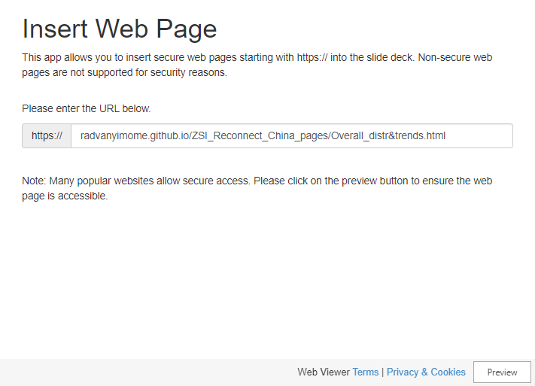
Overall Distribution & Trends
Bullet point 1
Bullet point 2
Bullet point 3

Slide 25
Overall Distribution & Trends
Bullet point 1
Bullet point 2
Bullet point 3

